Slide 1

Dimensionality Reduction

Slide 2
What is Dimensionality Reduction?
Dimensionality reduction is simply, the process of reducing the dimension of your feature set.
Your feature set could be a dataset with a hundred columns (i.e features) or it could be an array of points that make up a large sphere in the three-dimensional space.
Dimensionality reduction is bringing the number of columns down to say, twenty or converting the sphere to a circle in the two-dimensional space.

Slide 3
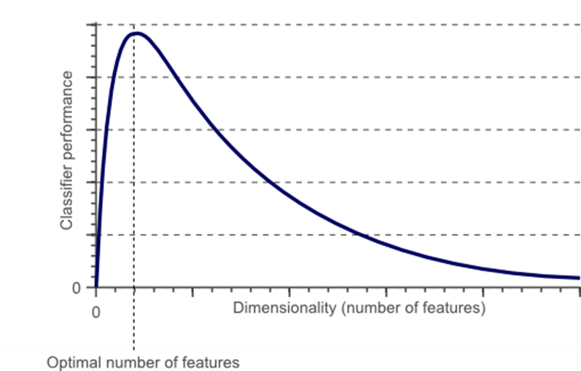
why should we care?
As the number of features increase, the number of samples also increases proportionally.
The more features we have, the more number of samples we will need to have all combinations of feature values well represented in our sample.

Slide 4
Consequences
Increase in the More complex model
number of features
The more the number The more the chances of features overfitting
Overfitting Poor performance on real data

Slide 5
Advantages
Less misleading data means model accuracy improves.
Less dimensions mean less computing. Less data means that algorithms train faster.
Less data means less storage space required.
Less dimensions allow usage of algorithms unfit for a large number of dimensions
Removes redundant features and noise.

Slide 6
Feature Selection and Feature Engineering for dimensionality reduction
Feature selection is the process of identifying and selecting relevant features for your sample:
Manually
Programmatically
Feature engineering is manually generating new features from existing features, by applying some transformation or performing some operation on them.

Slide 7
Feature Selection
Manually
Programmatically
Simple manual feature selections and reduce the dimensionality when the relevance or irrelevance of certain features are obvious or common knowledge.
Heatmaps that show the correlation between features is a good idea.
So is just visualising the relationship between the features and the target variable by plotting each feature against the target variable.
Variance Threshold
Univariate selection.

Slide 8
Variance Threshold
It is a baseline approach to feature selection.
It drops all features where the variance along the column does not exceed a threshold value.
The premise is that a feature which doesn’t vary much within itself, has very little predictive power.
X = [[0, 2, 0, 3], [0, 1, 4, 3], [0, 1, 1, 3]] selector = VarianceThreshold() selector.fit_transform(X) array([[2, 0], [1, 4], [1, 1]])

Slide 9
Univariate Feature Selection
It uses statistical tests to select features.
Univariate describes a type of data which consists of observations on only a single characteristic or attribute.
Univariate feature selection examines each feature individually to determine the strength of the relationship of the feature with the response variable.
Examples: Pearson Correlation, Maximal information coefficient, Distance correlation, ANOVA and Chi-square.
Scikit-learn exposes feature selection routines likes SelectKBest, SelectPercentile or GenericUnivariateSelect

Slide 10
Feature Engineering

Slide 11
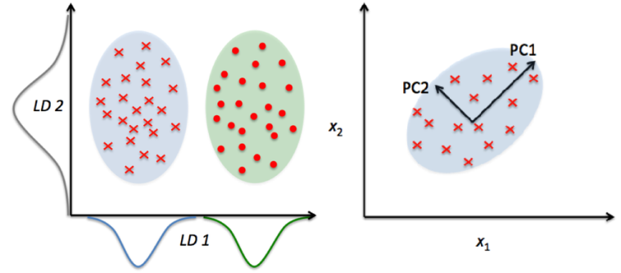
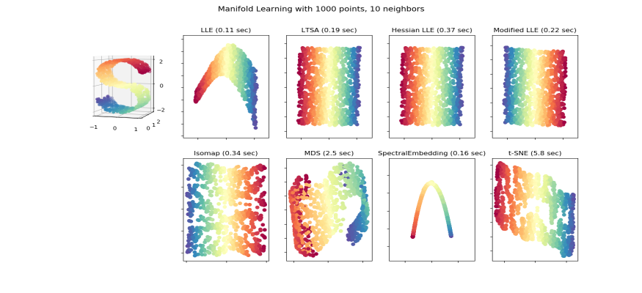
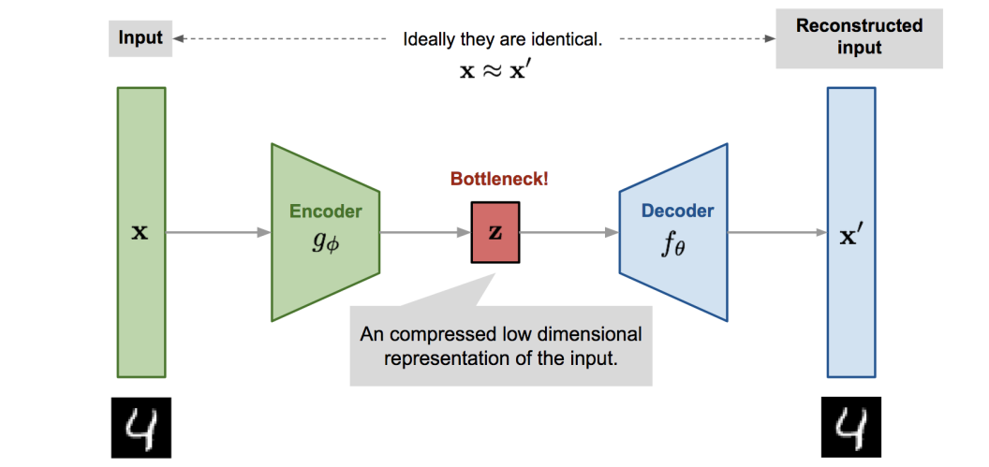
Types
Linear Dimensionality
Reduction Methods
Non-linear Dimensionality
Reduction Methods
Auto-encoders

Slide 12
Linear Dimensionality Reduction Methods
PCA (Principal Component Analysis) : Popularly used for dimensionality reduction in continuous data, PCA rotates and projects data along the direction of increasing variance. The features with the maximum variance are the principal components.
Factor Analysis : a technique that is used to reduce a large number of variables into fewer numbers of factors. The values of observed data are expressed as functions of a number of possible causes in order to find which are the most important. The observations are assumed to be caused by a linear transformation of lower dimensional latent factors and added Gaussian noise.
LDA (Linear Discriminant Analysis): projects data in a way that the class separability is maximised. Examples from same class are put closely together by the projection. Examples from different classes are placed far apart by the projection

Slide 13
Non-linear Dimensionality Reduction Methods
Multi-dimensional scaling (MDS) : A technique used for analyzing similarity or dissimilarity of data as distances in a geometric spaces. Projects data to a lower dimension such that data points that are close to each other (in terms if Euclidean distance) in the higher dimension are close in the lower dimension as well.
Isometric Feature Mapping (Isomap) : Projects data to a lower dimension while preserving the geodesic distance (rather than Euclidean distance as in MDS). Geodesic distance is the shortest distance between two points on a curve.
Locally Linear Embedding (LLE): Recovers global non-linear structure from linear fits. Each local patch of the manifold can be written as a linear, weighted sum of its neighbours given enough data.
Hessian Eigenmapping (HLLE): Projects data to a lower dimension while preserving the local neighbourhood like LLE but uses the Hessian operator to better achieve this result and hence the name.
Spectral Embedding (Laplacian Eigenmaps): Uses spectral techniques to perform dimensionality reduction by mapping nearby inputs to nearby outputs. It preserves locality rather than local linearity
t-distributed Stochastic Neighbor Embedding (t-SNE): Computes the probability that pairs of data points in the high-dimensional space are related and then chooses a low-dimensional embedding which produce a similar distribution

Slide 14
Auto-encoders
A type of artificial neural network that aims to copy their inputs to their outputs. They compress the input into a latent-space representation, and then reconstructs the output from this representation. An autoencoder is composed of two parts :
Encoder: compresses the input into a latent-space representation.
Decoder: reconstruct the input from the latent space representation.

Slide 15
PCA

Slide 16
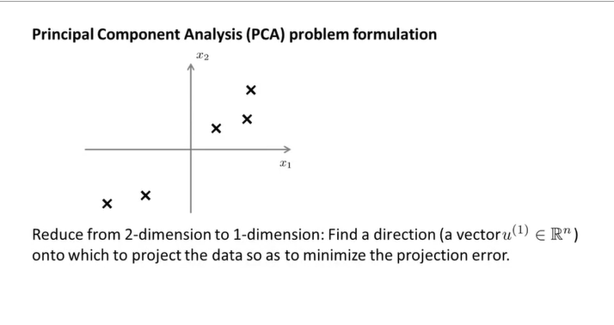
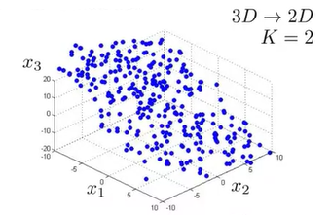

Slide 17
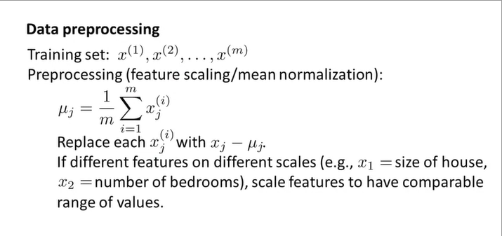

Slide 18
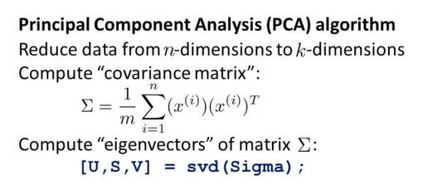
Singular value decomposition

Slide 19

Singular Value Decomposition Example In Python
In essence, SVD states that a matrix can be represented as the product of three other matrices. In mathematical terms, SVD can be written as follows:
where n is the number of rows (i.e. samples) and p represents the number of dimensions.

Slide 20
More definitions
For the case of simplicity we will focus on the SVD for real-valued matrices and ignore the case for complex numbers.
1 | A = U . Sigma . V^T
Where A is the real m x n matrix that we wish to decompose, U is an mxm matrix, Sigma (often represented by the uppercase Greek letter Sigma) is an m x n diagonal matrix, and V^T is the transpose of an n x n matrix where T is a superscript.
The diagonal values in the Sigma matrix are known as the singular values of the original matrix A. The columns of the U matrix are called the left-singular vectors of A, and the columns of V are called the right-singular vectors of A.

Slide 21
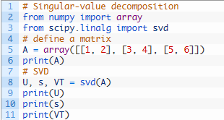
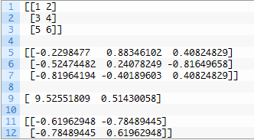
Calculate Singular-Value Decomposition
The U, s, and V elements returned from the svd() cannot be multiplied directly.

Slide 22
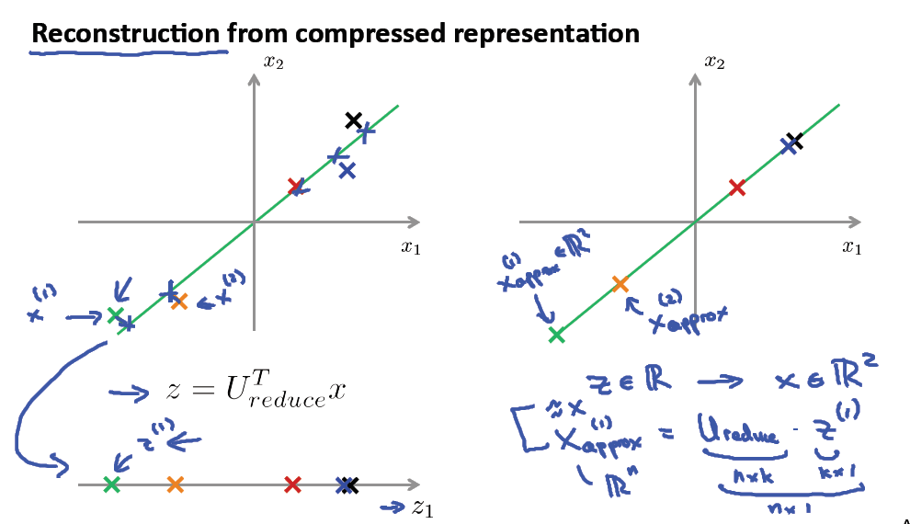

Slide 23
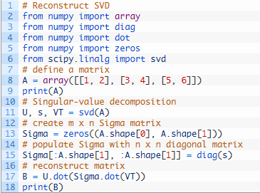
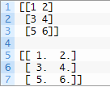
Reconstruct Matrix from SVD

Slide 24
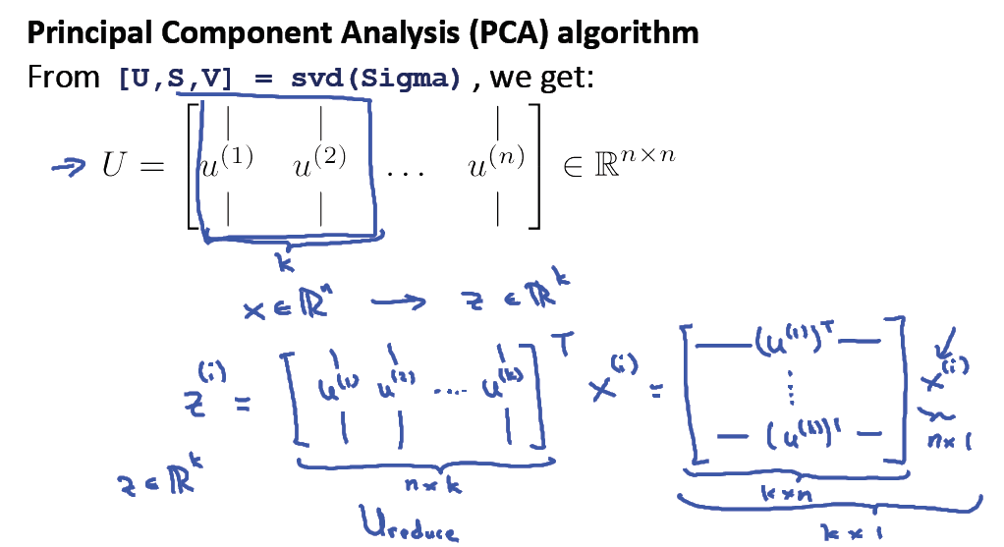
SVD for Dimensionality Reduction
Data with a large number of features, such as more features (columns) than observations (rows) may be reduced to a smaller subset of features that are most relevant to the prediction problem.
The result is a matrix with a lower rank that is said to approximate the original matrix.

Slide 25
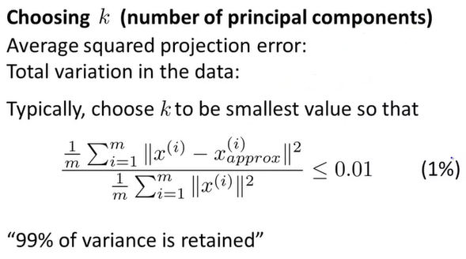

Slide 26
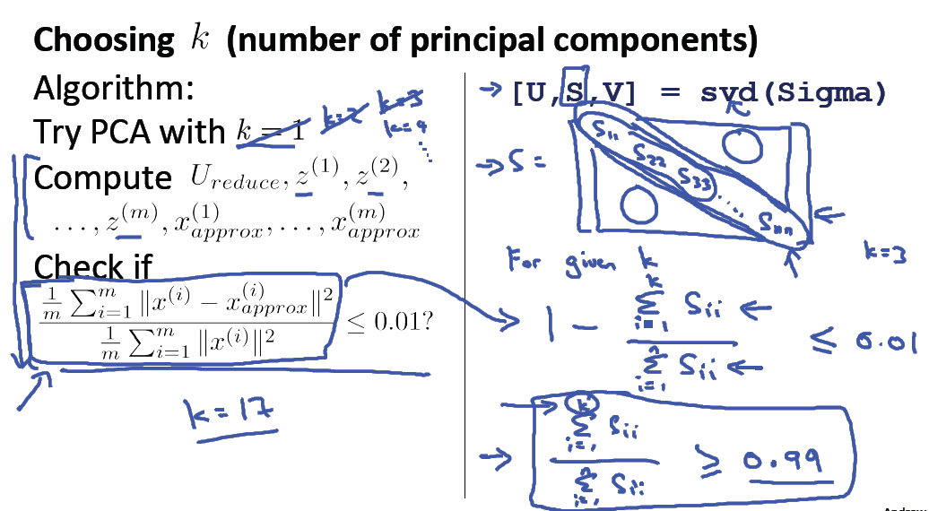

Slide 27
